Slide 1


AI Innovation in Quality Control: Harnessing Deep Learning and Convolutional Neural Networks to detect Defective Metal Parts in Manufacturing environment
3rd Data Science Intensive Capstone Project September 9th, 2024 By Javier Jorge Pérez Ontiveros

Slide 2
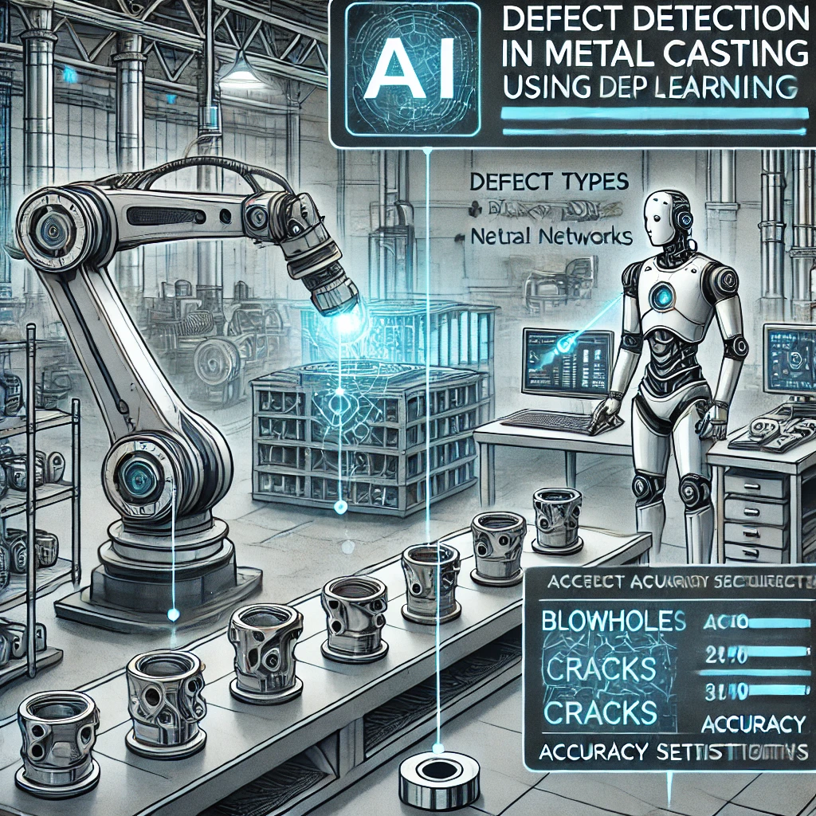
Executive Summary
This project used AI and Deep Learning (CNNs) to automate quality control in metal casting for submersible pump impellers, improving accuracy and efficiency over manual inspections
Key Points:
• Objective: Develop a CNN model to classify parts as “Defective” or “OK” with at least 95% accuracy and reduce inspection time by 50%
• Results:
• A custom CNN model achieved 98% accuracy
• A transfer learning model (VGG16) achieved 99% accuracy with faster implementation
• The system can process up to 90,000 pieces/hour, significantly improving efficiency
• Conclusion: Transfer learning proved more efficient for real-world deployment, offering high accuracy and saving time

Slide 3
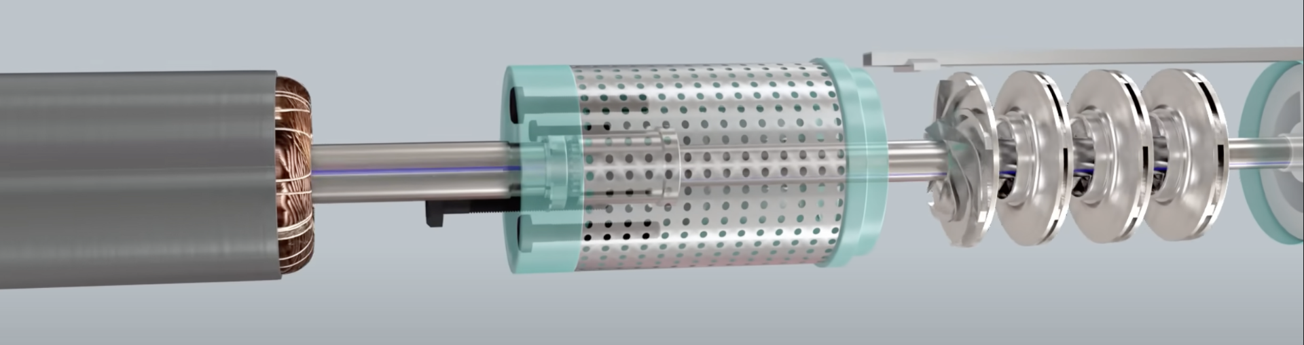
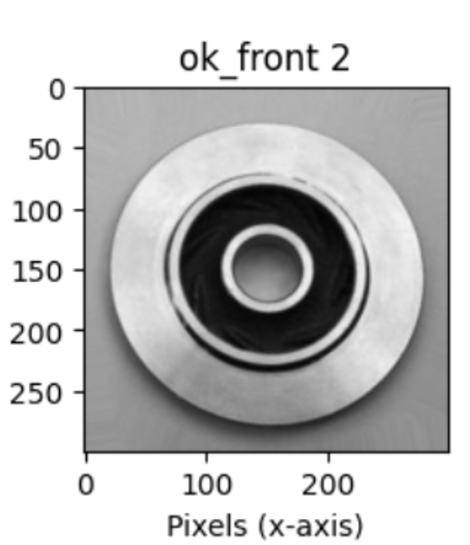
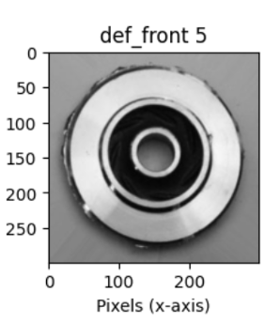
Product Application
The main problem in manufacturing metal casting products for submersible pump impellers is water leakage
Detection takes a lot of resources: time & labor
And can be inconsistent because of human errors
Defects like blow holes, pinholes, burrs, and shrinkage can cause significant financial losses if not detected correctly and on time
OK | Defective Part

Slide 4
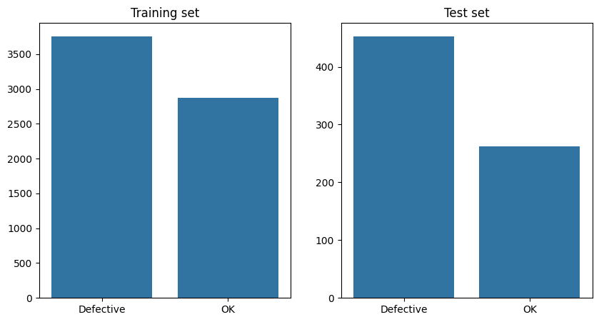
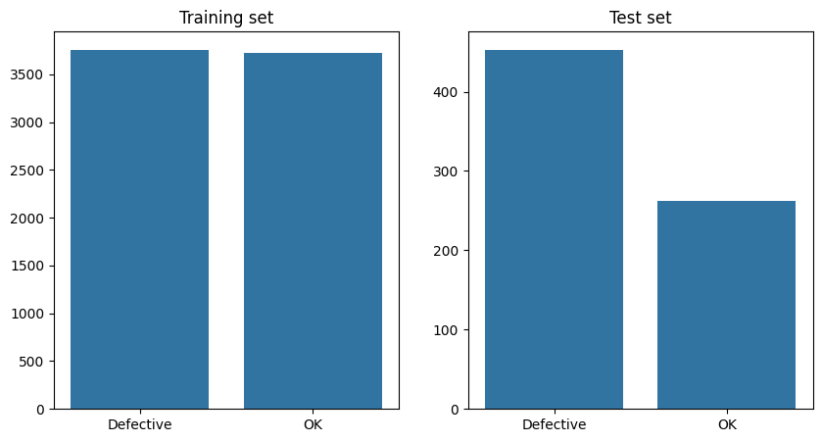
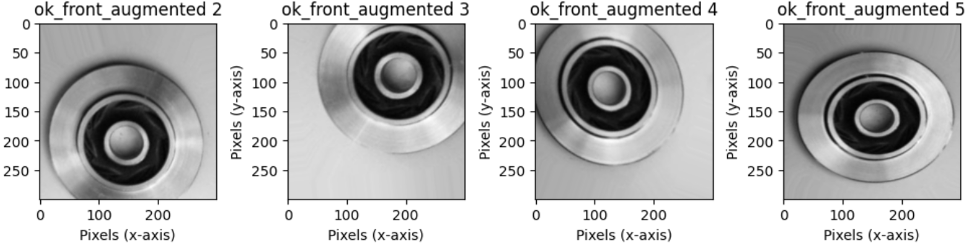
Data Wrangling
As the training set was imbalanced, Data Augmentation Techniques were utilized to generate new pictures scenarios: Rotation, Zoom, Flips, Brightness, etc

Slide 5
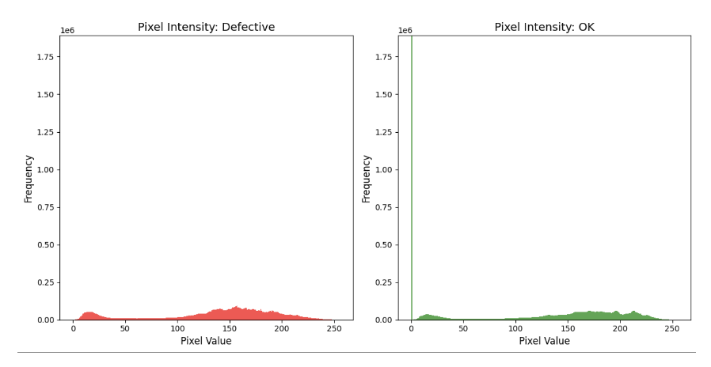
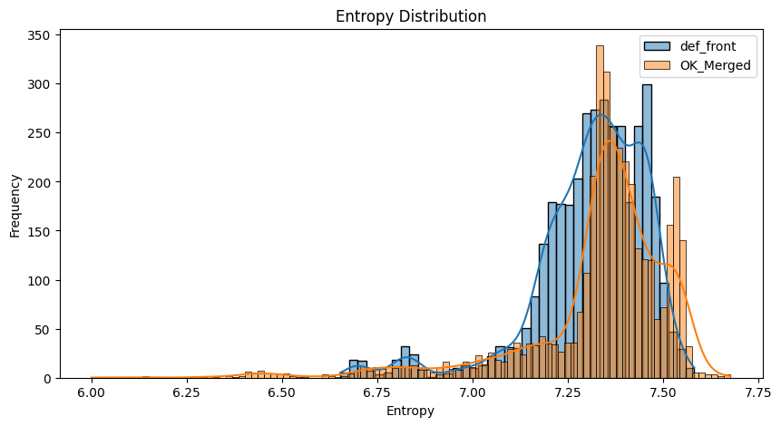
EDA
Pixel intensity was tested in both samples, showing a slight difference between the two groups, but the pattern is not easily identified by humans
Entropy was also measured to identify differences between two categories of pictures by helping quantify the level of uncertainty or “disorder” in the image data
These 2 Analysis revealed differences in pixel intensity distribution, which could indicate unique characteristics in defective pumps

Slide 6
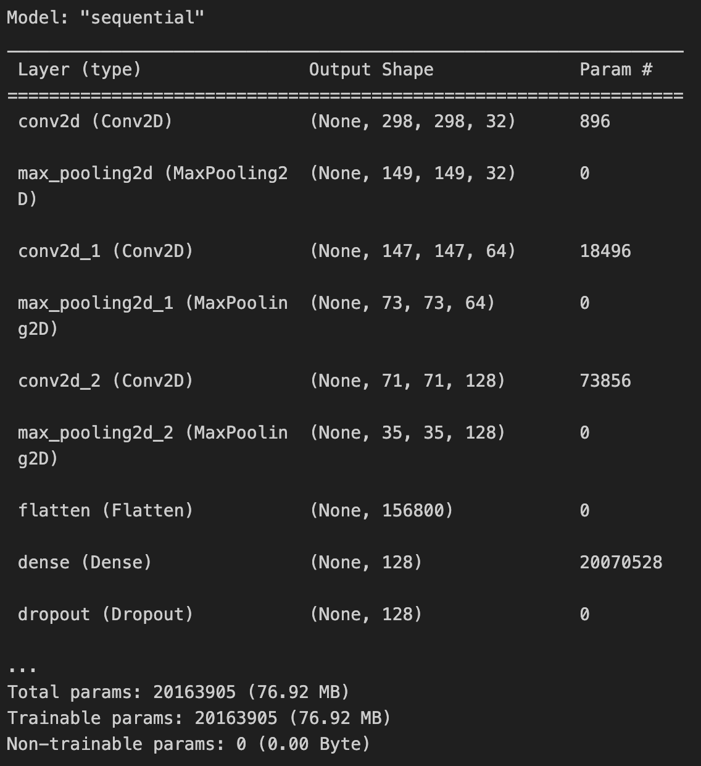
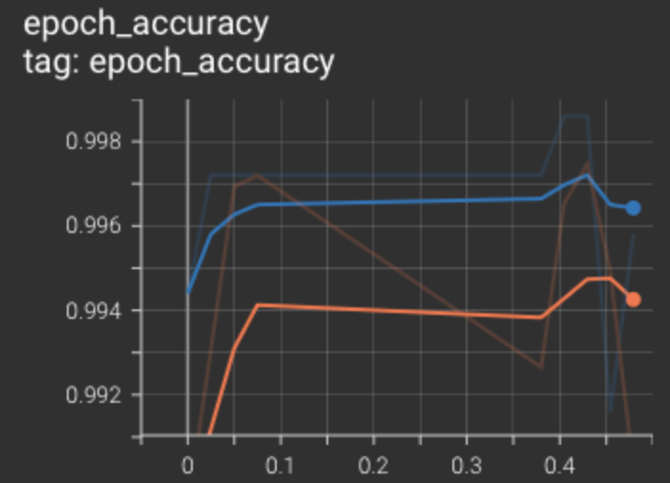
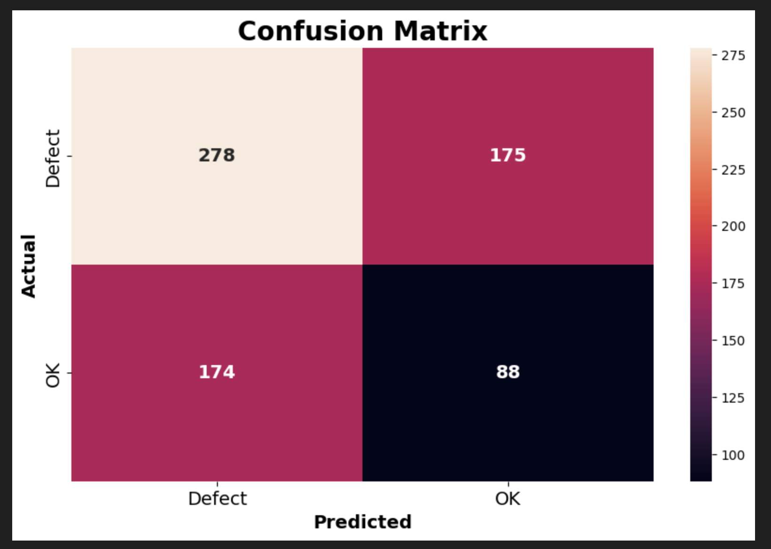
First CNN Model Creation
During Training the model achieved an 98% accuracy, however when it was tested on “unseen” data, this dropped quickly to 63% accuracy

Slide 7
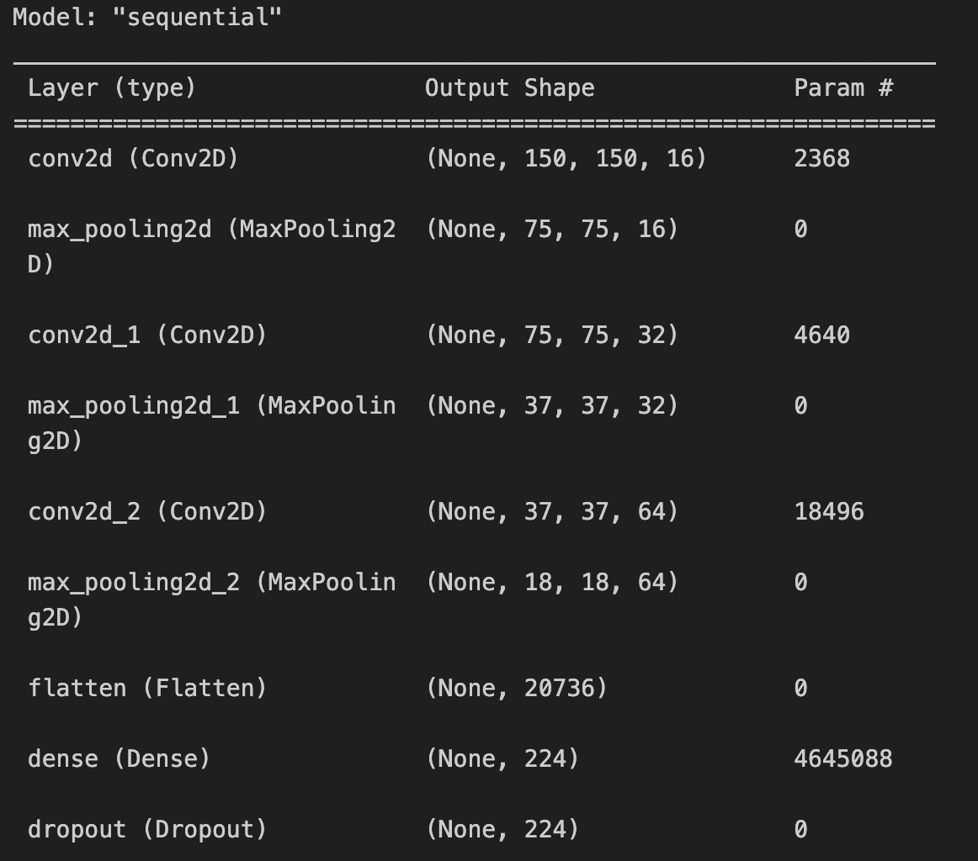
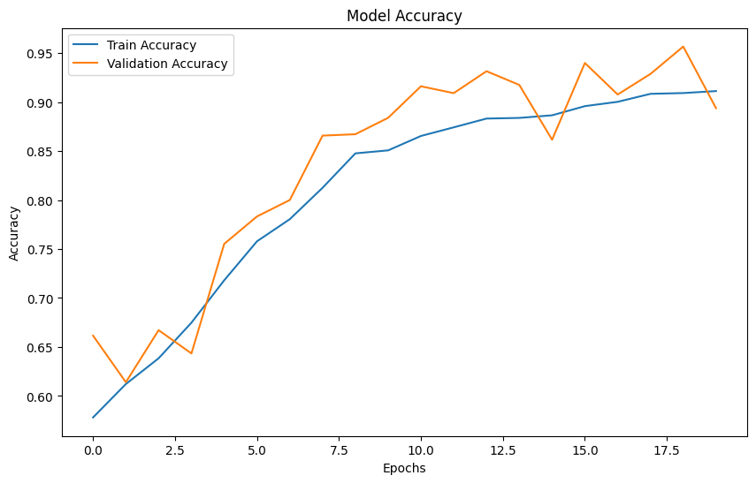
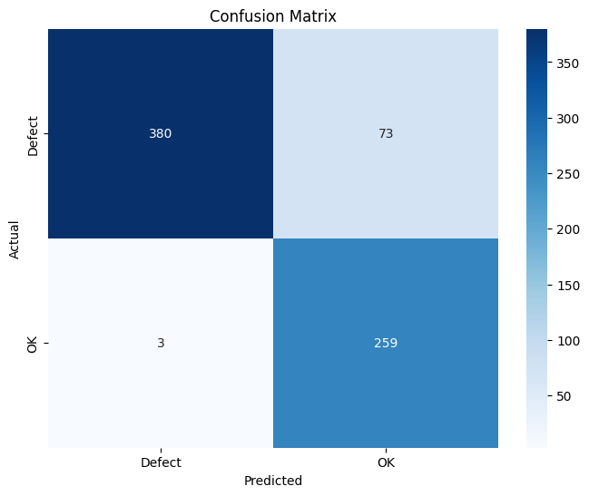
Second CNN Model
In this model, the Architecture was changed to a Simpler model design
After the first training the Accuracy achieved was up to 89%

Slide 8
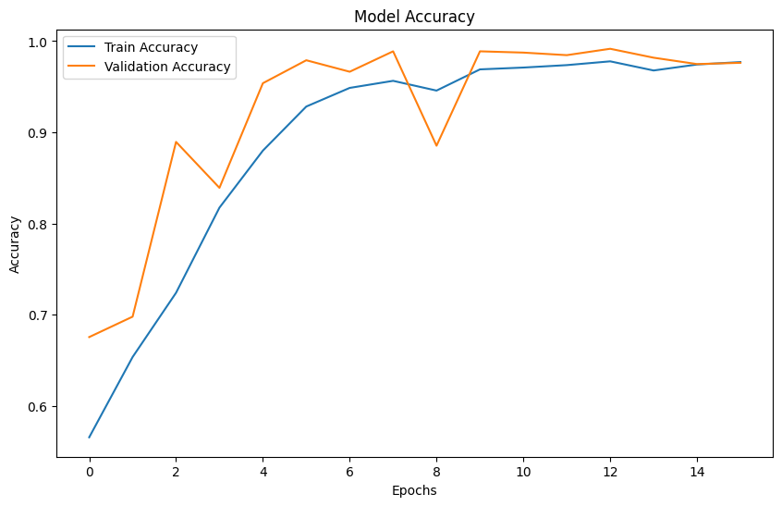
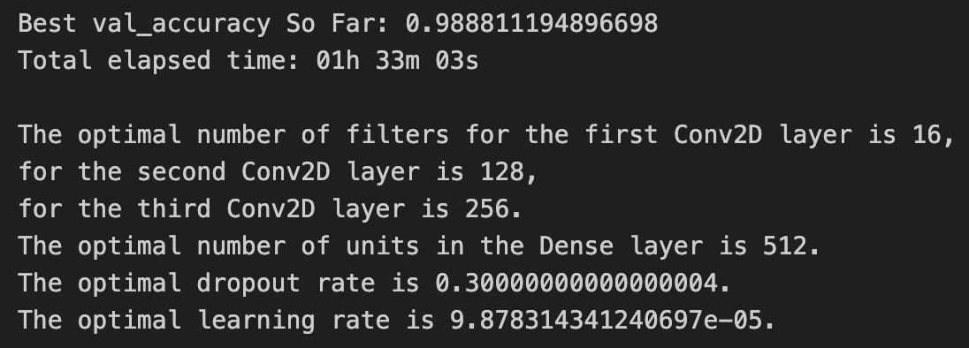
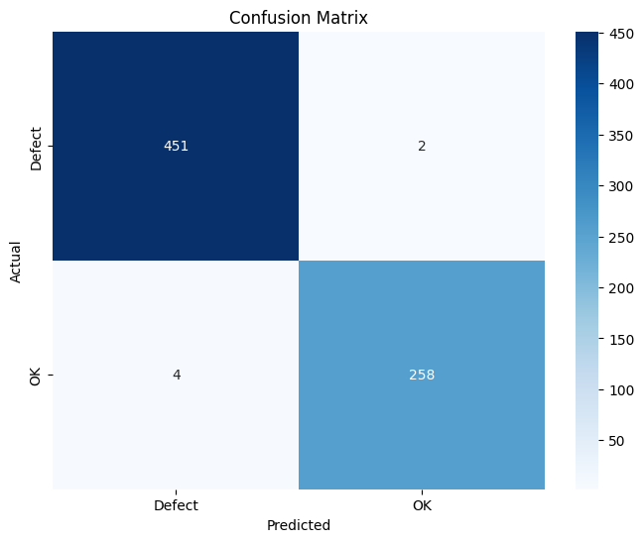
Hyperparameter Tunning
16 out of 20 epochs were compiled (Early stop was activated when the model stopped improving accuracy).
With this hyperparameter tunning the accuracy improved > 98%

Slide 9
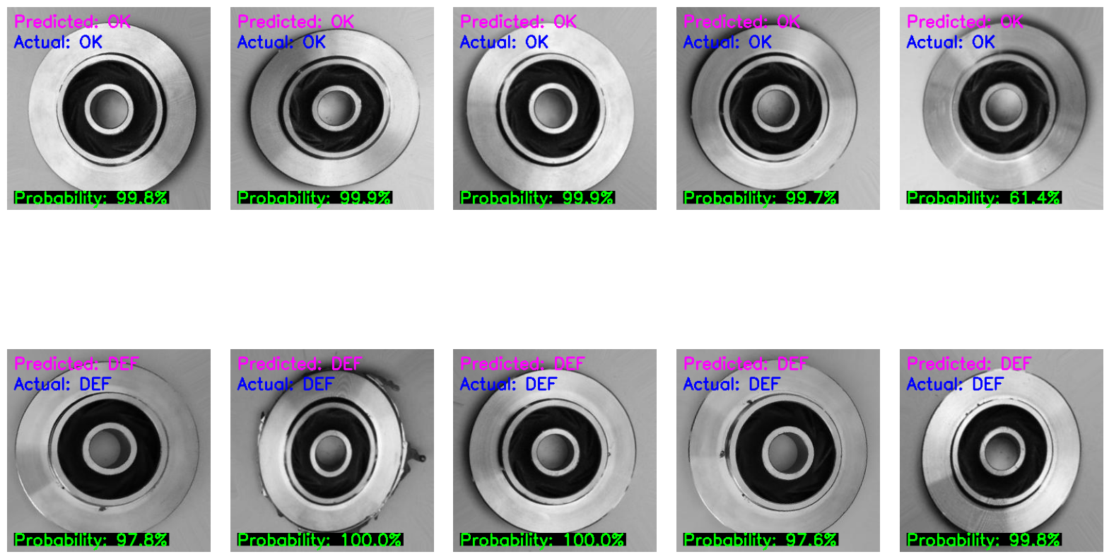
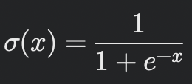
Results and Evaluation of Second Model
This visual representation of 10 random pictures (5 OK & 5 Defective), the Actual Labels can be observed in Blue and Predicted Values in Pink.
The probability (Green), is obtained from the Sigmoid Activation Function in the last layer of the model.
All pictures of the random sample were correctly classified
Prediction Number represents how certain is the model of the decision taken

Slide 10
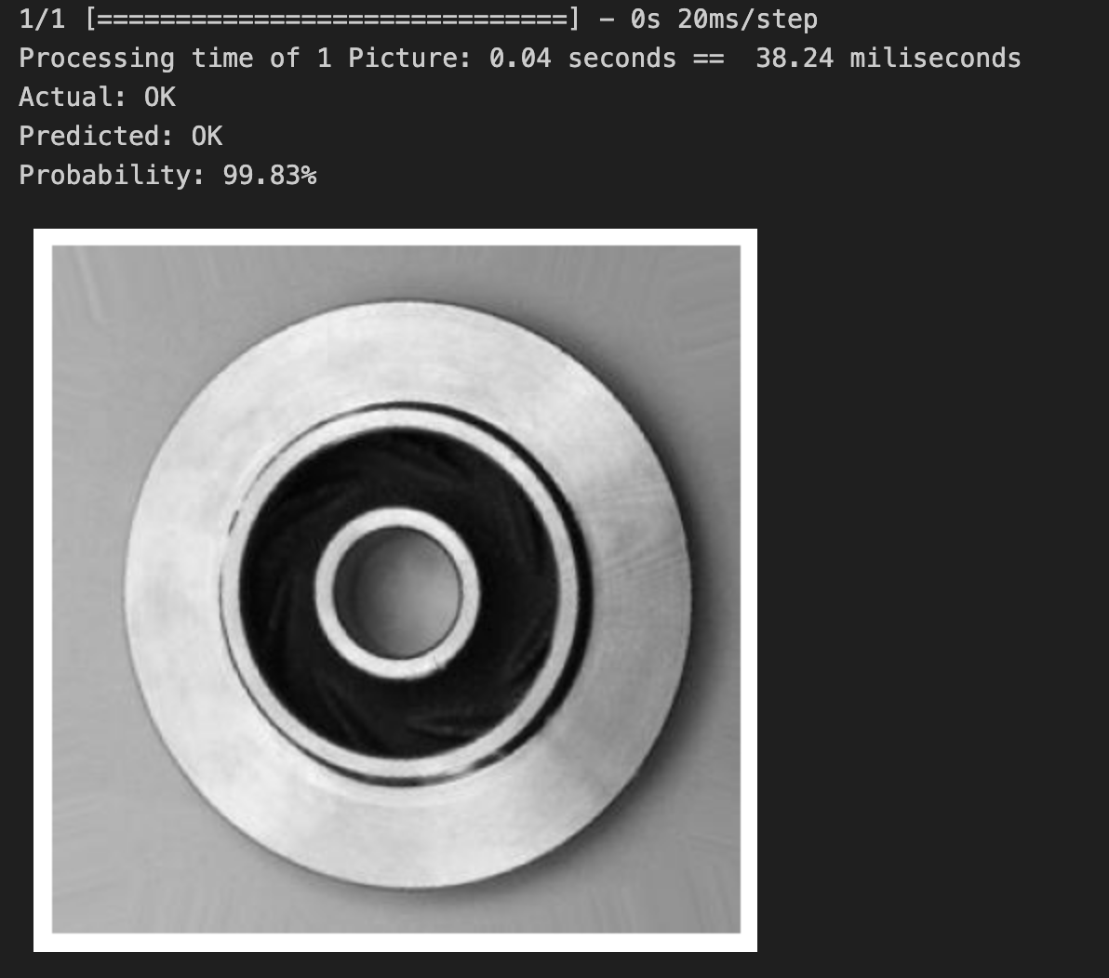

Processing Time of 1 Part
A computer clock was stablished before and after running trials, and the best processing time was 0.04 seconds per piece.
This means that the Neural Network could analize up to 90,000 pcs/ hr!

Slide 11
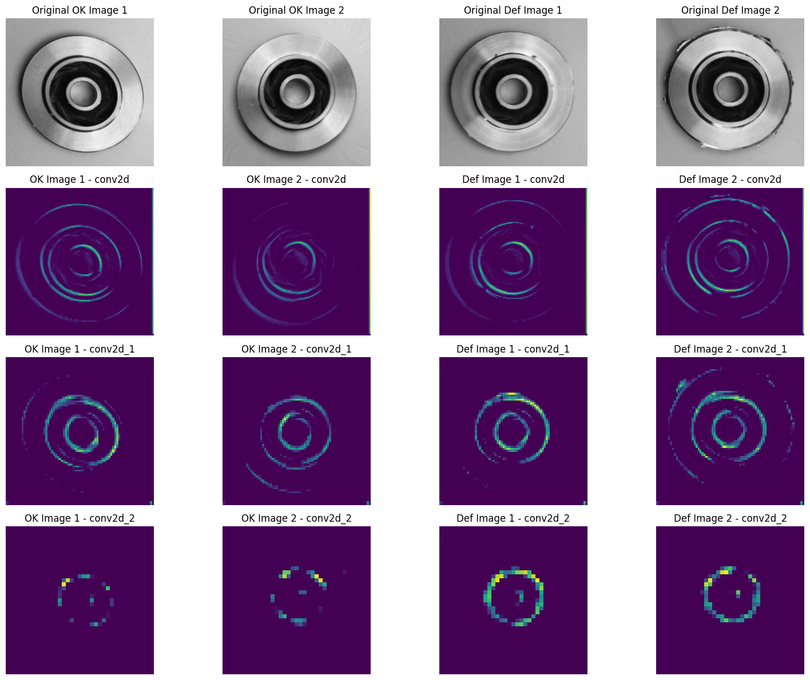
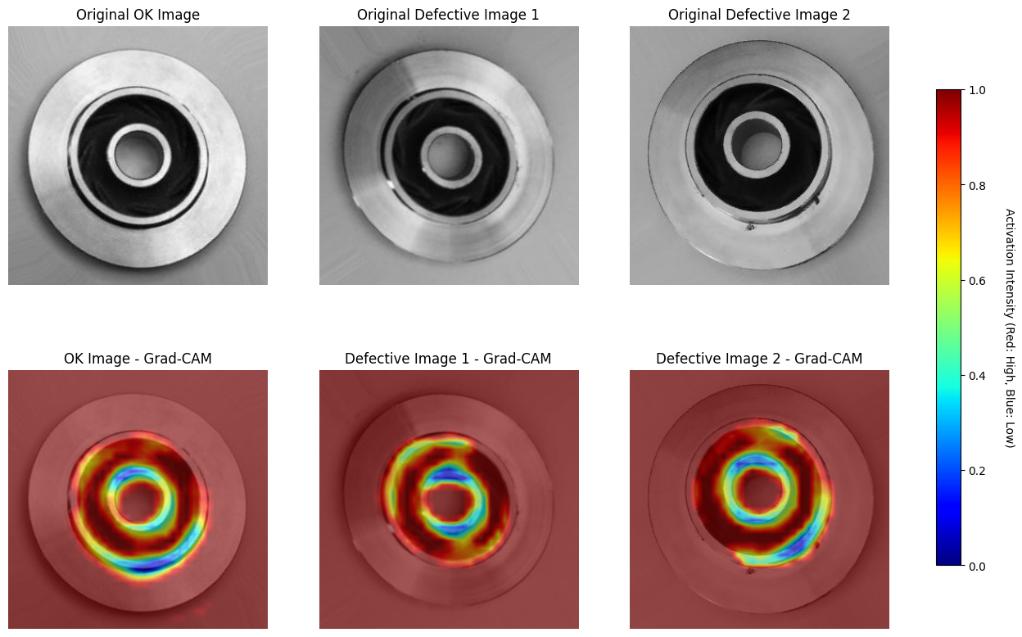
How the model ‘see’ the defects
Using Keras Model and Image modules, the outcome of the 3 layers of Convolutional Neural Networks was visualized to see how the model “captures” the defects.
Using Grad-Cam combined with Tensor flow, the pixel Activation Intensity was visualized. Red Areas are zones that are highly considered by the model, while blue areas are areas that the computer somehow “ignores”.

Slide 12
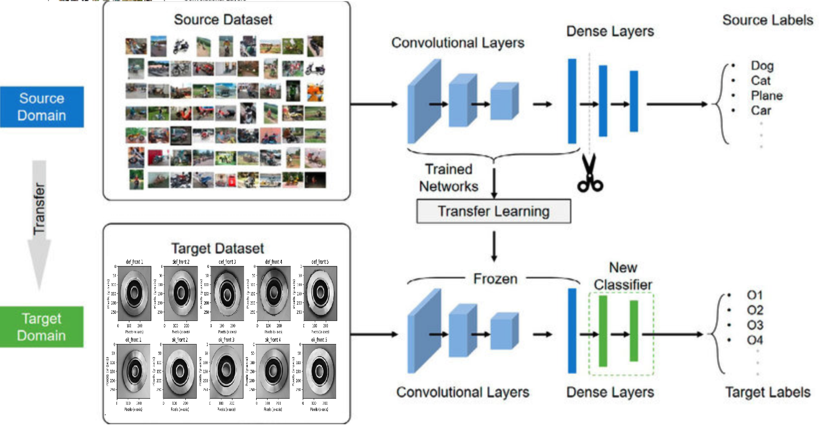
Transfer Learning
• Transfer Learning reuses pre-trained models (e.g., ResNet, VGG) that have learned to detect general visual features like edges and textures.
• VGG16, pre-trained on ImageNet (14 Million images, 1,000 categories), was fine-tuned for defect detection in metal casting.
• In this project, the first 13 convolutional layers were used as feature extractors, and custom dense/dropout layers were added for binary classification
Transfer Learning reduces resources needed and improves model focus on relevant features while preventing overfitting

Slide 13
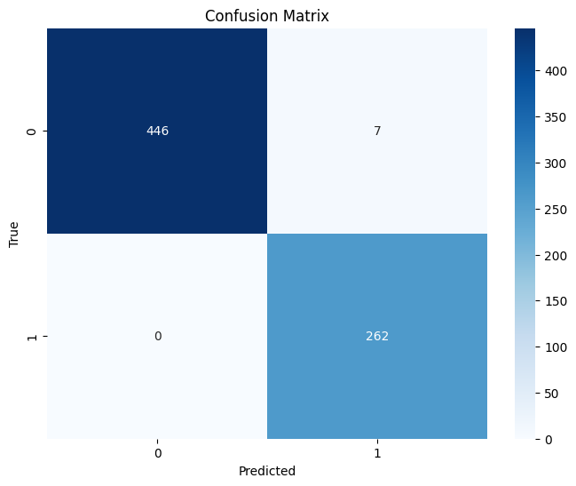
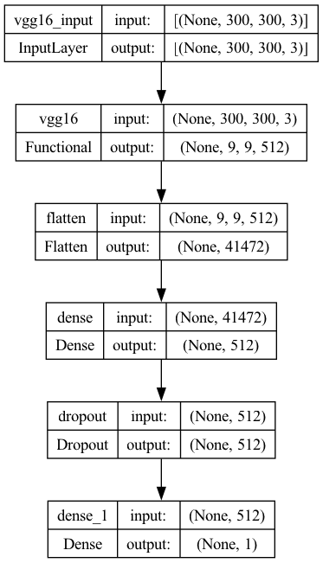
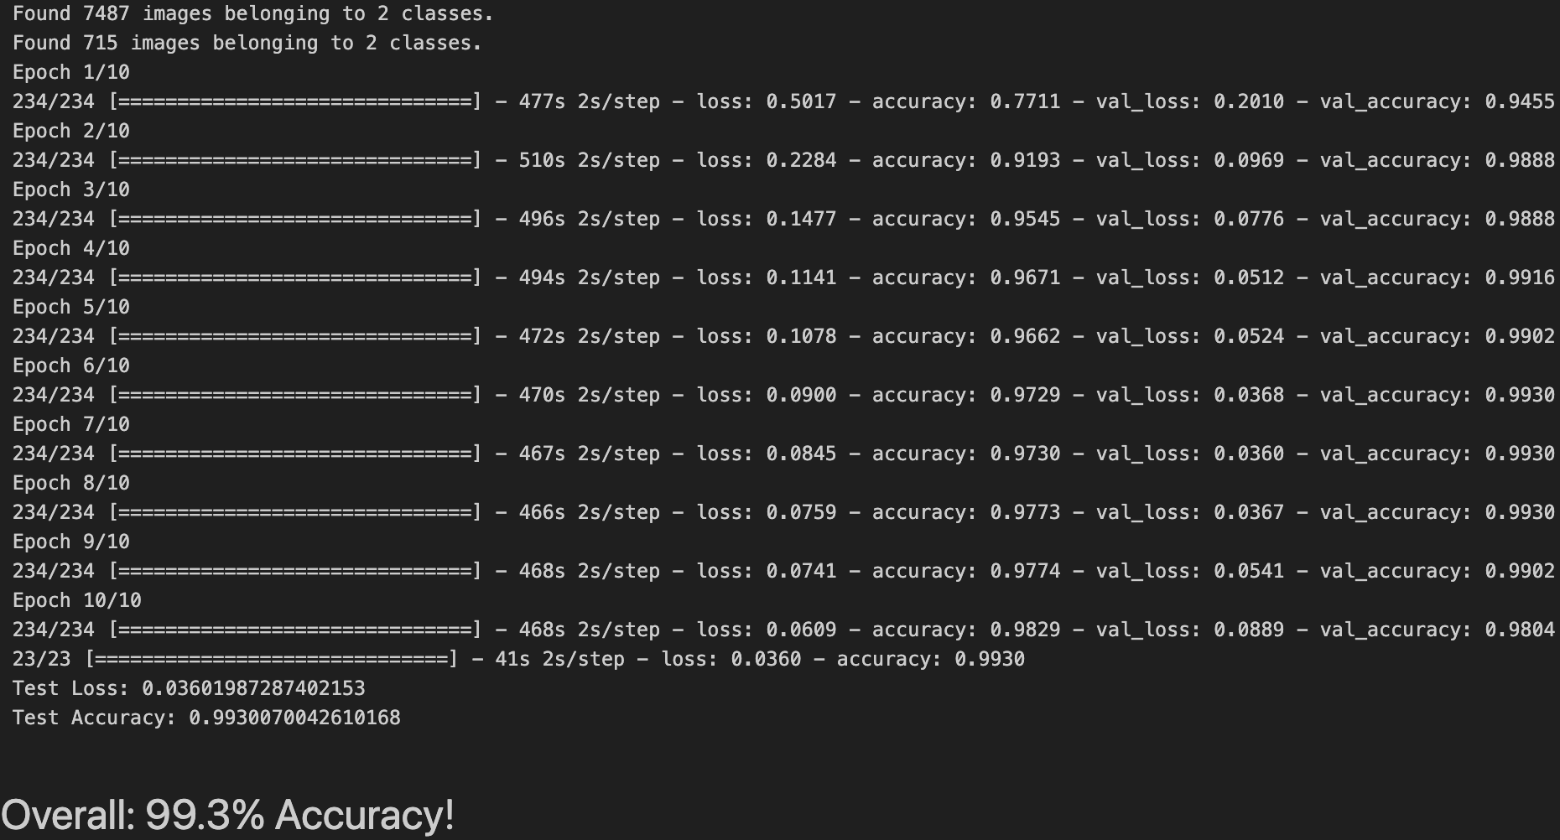
Transfer Learning Performance
The Transfer Learning model achieved a high accuracy (99%) since the 4th Epoch
Further modification of its layers wasn’t necessary

Slide 14
Model Selection
While building a model from scratch was a good exercise to practice the concepts learned during the Data Science Certification.
If I had to start this project again, I would select Transfer Learning method as a starting point due to its simplicity for implementation.
Conclusion
The model from scratch reached 98% accuracy, showing that it could learn and generalize the key features needed to classify metal parts. Initially, the model was too complex and overfitted, but after simplifying it, it worked well.
But Transfer Learning model extremely well with 99% accuracy, with the benefit of saving a lot of time and resources, since the pre-trained model already had a good understanding of general visual features.

Slide 15




Thank you!
https://www.linkedin.com/in/jjpo/
javierjorge77@gmail.com
https://github.com/javierjorge77/Springboard/tree/main/Capstones/Capstone3_backup
(+521) 8711777903

